Slide 1


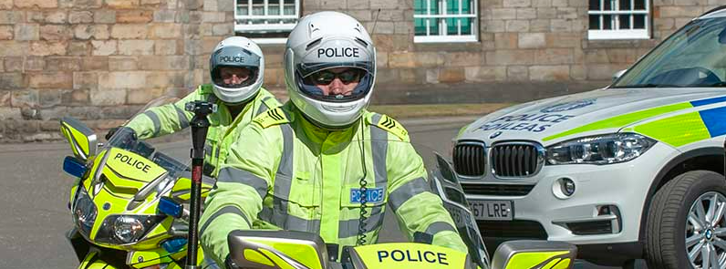
In-Depth Roads Fatalities Study
1st January 2015 – 31st August 2024
Motorcycles
Police Scotland
26 March 2025
OFFICAL
OFFICAL

Slide 2
Overview/Background
Collaboration between Police Scotland and Transport Scotland to provide analysis of fatal collisions on Scotland’s roads.
Previous In-Depth Roads Fatalities Study focused on all road users, between 2015 and 2020.
“Further in-depth analysis should be undertaken on the currently available data set to identify trends and subsequent recommendations for pedestrians, motorcyclists, pedal cyclists and child fatalities.”
Vision to have the best road safety performance in the world.
Analysis will focus Motorcycle riders and passengers.

Slide 3
Aims of the Report
Identify fatal collisions involving motorcycle riders and passengers.
Identify the contributory factors that led to the fatal outcome of the collisions.
Identify the countermeasures that could have prevented the fatal collisions or reduced the severity of injury.
Explore road users in relation to specific contributory factors and countermeasures.
Make recommendations to assist in addressing identified themes and issues.

Slide 4
Methodology/Data Sources
Experienced Roads Policing officers reviewed every fatal collision, quality assured by a senior Road Policing supervisor
Recruitment of an experienced analyst, dedicated to the project
Enhanced dataset
  CRaSH
  Collision Investigation Reports
  Police Scotland internal reports
  STATS 19
  Criminal History System
Aligned to the five Safe System Pillars

Slide 5
Overview - Fatalities
18% of all fatalities during the reporting period were a motorcycle rider or passenger.
Despite motorcycles only being estimated to account for less than 1% of traffic in Scotland.
4% of the riders and passengers found not to be wearing a helmet.
258 Collisions
253 Riders
246 Males
7 Females
269 Fatalities
16 Passengers
4 Males
12 Females

Slide 6
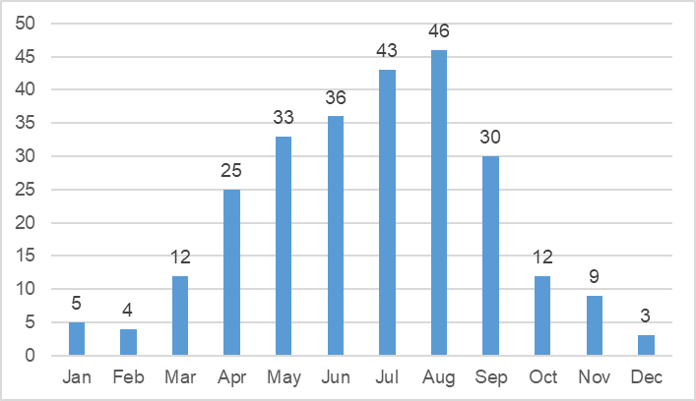
Temporal Profile
The most fatal collisions occurred during the summer months, with the highest recorded during August (rural n=38, urban n=8)
43% of fatal collisions occurred during the weekends and most commonly on a Sunday during July (n=15) and Saturday during June (n=13)

Slide 7
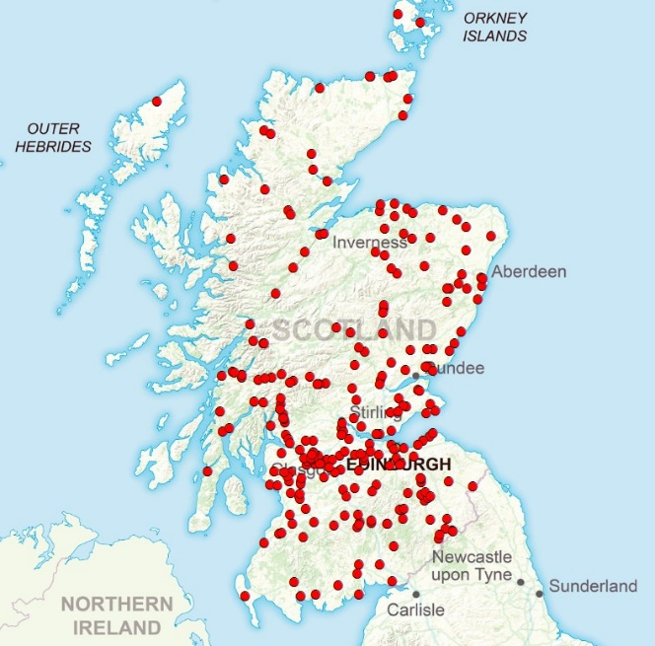
Locations
The highest number of fatal collisions occurred within Highland Local Authority, followed by Argyll & Bute and Scottish Borders.
Most recorded on the A82 (n=19) and A85 (n=15) .
Most commonly fatalities occurred on 60mph ‘A’ Class roads, with four taking place on a motorway (M74, South Lanarkshire).
‘Cornering (left hand bend)’ and ‘overtaking and lane change’ were the most common collision types, accounting for a combined 45% of collisions¹.
¹Please note, the ‘collision type’ may not relate specifically to the motorcycle, but other vehicles involved in the collision.

Slide 8
Key Findings – ‘Failed to judge path/speed’
52 cars attributed ‘failed to judge others path/speed’.
Overall, there were 65 fatal collisions involving a motorcycle fatality, where ‘failed to judge others path/speed’ was attributed to a non-motorcycle.
Of those collisions, 45 occurred at a crossroads, junction, roundabout or ‘T’ junction.
Although this was most commonly recorded on the A82 (n=6), a visual observation of the locations highlights a pattern in the east coast, which could relate to a popular motorcycle route.

Slide 9
Key Findings – ‘Poor turn or manoeuvre’
48 fatal collisions - ‘poor turn or manoeuvre’ (attributed to a non-motorcycle).
The most collisions occurred within Dumfries & Galloway local authority (n=6), followed by Aberdeenshire and Highlands (both n=5).
Rural and Urban - four collisions were recorded within Glasgow City.
Most commonly recorded on the A82 (n=7).
Common to 11 collisions which occurred between Dundee, Aberdeen and Elgin along the A92 and A96 (including other surrounding roads).

Slide 10
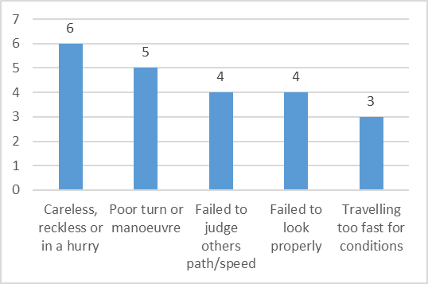
Key Findings – ‘Cluster Analysis’ – 1500 metres
This highlighted six collisions which occurred on the A836 along a 45 mile stretch on the north coast of Scotland.
‘Careless, reckless or in a hurry’ was common to all collisions, with ‘poor turn or manoeuvre’ being recorded against five of the collisions.
Three of the collisions occurred on a bend.

Slide 11
‘Riders at Fault’
258 Collisions
208 Riders At Fault
261 Motorcycles Involved
203 Males
5 Females
117 Excessive Speed Contributory Factor
Age 26-35 (n=33)
Age 46-55 (n=24)
Rider ‘at fault’ indicates that the behaviour / actions of the rider are likely to have contributed to the occurrence of the collision and the rider bore some responsibility. It should be noted that more than one road user can be found ‘at fault’ in any given collision.
Highest number of riders ‘at fault’ were recorded in the 26-35 age group (n=49), followed closely by the 46-55 age group (n=47).
Majority of riders aged between 26-65 (n=167, 80%)

Slide 12
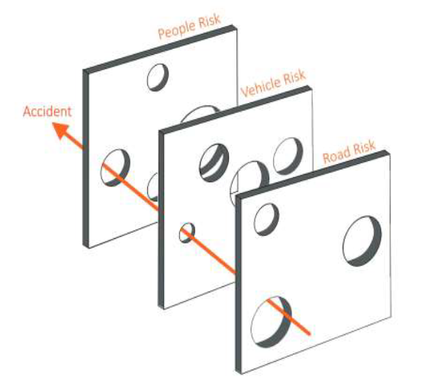
Countermeasures
Countermeasures were identified that if implemented at any stage of the collision (pre, post or during), were assessed to have an impact on the outcome: either stopping the collision from occurring at all or reducing the severity of injuries sustained.
Priority locations for consideration of speed reduction or the addition of barriers, traffic lights, or speed cameras have been identified.

Slide 13
Recommendations
Contributory Factors, Countermeasures and identified trends have informed the 44 recommendations.
Recommendations have been aligned with the pillars of the Safe System.
The recommendations vary between quickly achievable and at minimal cost, those that require multi-agency partnership working to deliver, and strategic, long-term goals which require legislative change and a whole-system approach to deliver on.

Slide 14
OFFICAL
Thanks for listening
OFFICAL

